Slide 1


Consulting on an Island: A Novel Approach to Teaching Statistical Collaboration Skills
Joint Statistical Meetings, Seattle
August 11, 2015
Ann M. Brearley, Barbara R. Kuzmak, Marta D. Shore, and Laura J. Le
Division of Biostatistics and School of Statistics
University of Minnesota

Slide 2
ASA Curriculum Guidelines for Undergraduate Programs in Statistical Science (2014)
“Real applications. …Programs should …provide experiences in designing studies and analyzing non-textbook data.”
“Ability to communicate. Students need to be able to communicate complex statistical methods in basic terms to managers and other audiences … Programs should provide multiple opportunities to practice and refine these statistical practice skills.”
How?
www.amstat.org/education/curriculumguidelines.cfm
Notes:
Experience as a consulting or collaborative statistician is one great way to get experience with real problem solving and real data, and to hone verbal and written communication skills.
However, it can take a great deal of effort, or even be impossible, for an instructor to find suitable collaboration opportunities for students that fit within a one-semester time frame.

Slide 3
Collaborative Approach
Notes:
Collaboration in two senses: 1) curriculum collaboration between Biostatistics and Statistics; 2) statistical collaboration between students in the two classes.
Teams of three senior statistics majors in Stat 4893W serve as statistical consultant / collaborators for client teams of public health graduate students in PubH 6414 (one team to one team)
Meet with clients via Google Hangouts. Together: design, carry out, analyze and report a clinical trial.

Slide 4
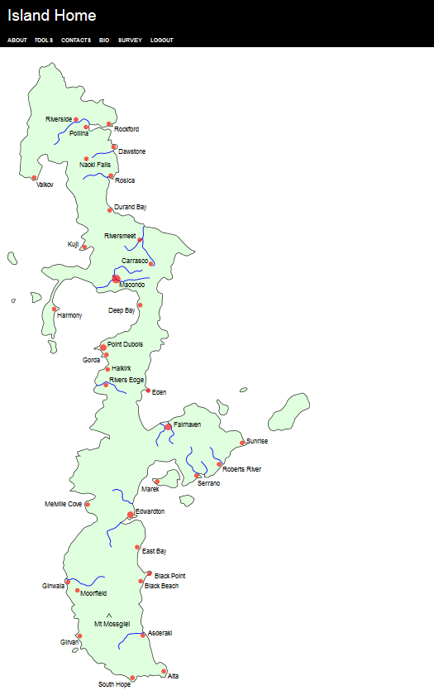
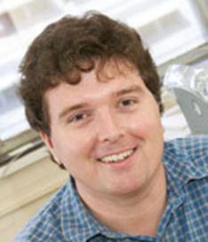
Bulmer, Michael and Haladyn, J. Kimberly (2011).
“Life on an Island: a Simulated Population to Support
Student Projects in Statistics.”
Technology Innovations in Statistics Education (TISE) 5(1).
http://escholarship.org/uc/item/2q0740hv
http://island.maths.uq.edu.au
Notes:
Briefly describe Island itself.

Slide 5
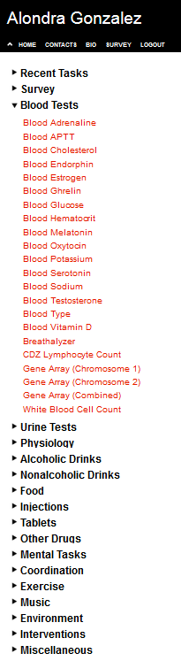
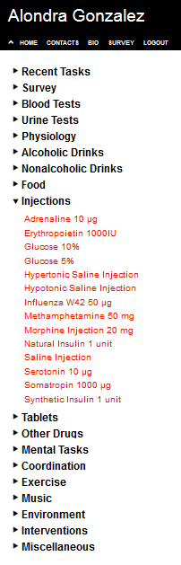
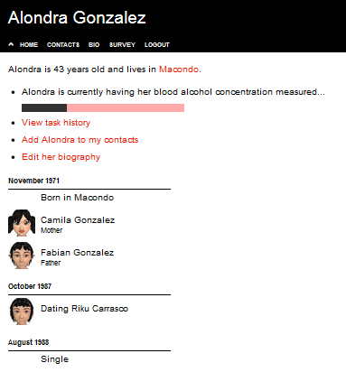
Notes:
How the Island works, cont. – kinds of interventions and outcomes available, how you do an experiment.

Slide 6
Notes:
Roles and Timing – slow down and describe each step – this is the heart of the talk.

Slide 7


Island Studies Examples
Effects of Methamphetamine on Cognitive Function in Young Adults
RE-WINE: The Effect of Red Wine on Serotonin Release
The Effect of Cannabis Tea on Short Term Memory Scores
Effect of diabetes on the blood glucose level of “The Island” population after exercise
YIKES! Youth Islander Knowledge Enhancement Study [Effect of Dextroamphetamine on Arithmetic Performance]
Effects of Smoking on Pulmonary Functioning and Exercise Tolerance
Effects of Music on Blood Pressure
The DREAM Study: The Effect of Different Exercise Assignments on Melatonin
Notes:
Titles and images are from Fall 2013 Online student projects

Slide 8
Evaluation and Improvement
Instructors need to moderate the client/consultant meetings
Draw out both consultants and clients to talk when needed
Prompt both sides to be clearer when necessary
Correct bloopers
Altered group sizes to have few enough groups to be able to monitor them effectively
Reduced number of required meetings
Developed clearer instructions: e.g. flowchart, meeting checklists
Found that many of the consultants needed to review basic statistics, sample size estimation. Added review material.
Added role playing exercises to prepare for the client meetings
Notes:
Over the past three semesters:
Formal evaluations were done to assess and improve the collaboration (both senses)
Surveyed both ‘clients’ and ‘consultants’
Used Qualtrics online survey tool
Also had a formal ‘debriefing’ meeting for instructors to discuss what worked and what didn’t work, at end of each semester
Blooper example “Confidence intervals cannot be used for inference”

Slide 9
Benefits for Student/Clients
Application – Students apply the concepts and methods they learn in class to a ‘real’ study
Study design, sampling methods
Collecting and organizing (and cleaning!) data
Analysis and interpretation
Collaboration – Students learn the necessity of teamwork, across specialties, to carry out a research study. They learn what works well and what doesn’t for a cross-functional geographically dispersed team.

Slide 10
Benefits for Student/Consultants
Provides experience with real clients / real challenges
Develops problem solving skills
Provides speaking and writing experience
Generates interest from potential employers:
“I had an interview at the Federal Reserve Board where I discussed my consulting experience. They seemed very impressed that I got such an experience.”
“I recently had an interview and they were interested in [my] interactions with the biostats students, the results that my group came up with and the Island program itself.”

Slide 11
Benefits for Instructors
Improves teaching
Brings out issues students are having difficulty with, e.g. random sampling vs. random assignment. Provides a built-in example to use in explanations.
Provides reality check for the effectiveness of the undergraduate statistics program
Makes instructor-student relationship more collegial
Instructors/TAs become statistical collaborators. (Instructor doesn’t know ‘the answer’!)
Vastly increases the amount of non-homework-, non-exam-related interaction with students.

Slide 12
Conclusions
Many positives
Plan to continue into 4th semester this fall
Biggest challenge: scalability
TAs with consulting experience help!
Future: Add peer-review?
Notes:
Many positives. We piloted this in Spring 2014 and have refined and improved it in the two following semesters. Plan to continue.
Biggest challenge is scalability: balancing instructor(s) time (ideally fewer larger groups) with need for small working groups (ideally many small ~3-5 student groups). Using TAs with consulting experience has helped here.
Future idea?: implementing several stages of peer-review, in addition to instructor monitoring and review. As done for SIBS 2015: each section of a group’s report (intro, methods, results, discussion) is reviewed by two other groups, using the CONSORT guidelines as a rubric, who provide extensive comments and suggestions for improvement (via Google Docs).

Slide 13

Questions?
brea0022@umn.edu

